Slide 1

Sunday Training
Presented by Department Membership Chairman
Wendi Hall

Slide 2


Slide 3


Slide 4

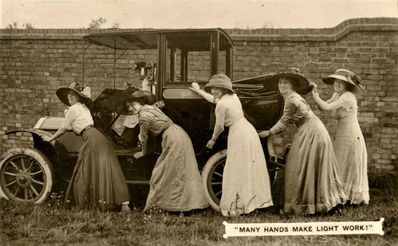

Slide 5
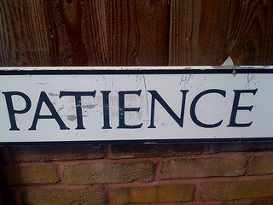



Slide 6




Slide 7


Slide 8


Slide 9



Slide 10

Travel Services
Dental and Vision
Cancer Grants
Critical Care
Hearing Plans
Medical Supplement
Auto and Home Insurance
Community Awareness for Veterans
Long Term Care
Friendships

Slide 11



Slide 12


Slide 13


Slide 14


Slide 15


